Slide 1
Group Design Sprint 4
Humzah Mohyuddin, Jamel Douglas, Alicia Thimothee,Sarah Megna

Slide 2
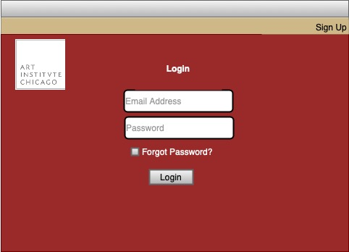
Login Page

Slide 3
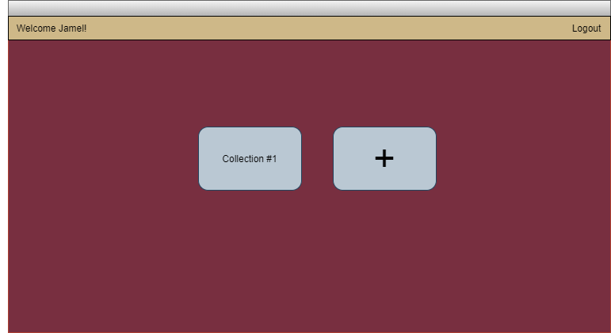
Dashboard

Slide 4
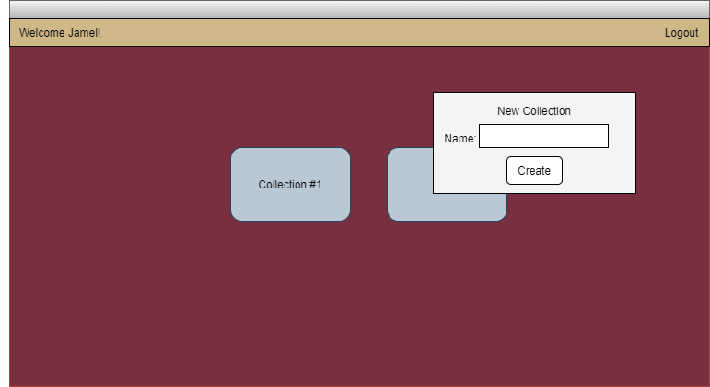
Dashboard

Slide 5
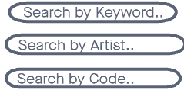
Advanced Search Page

Slide 6
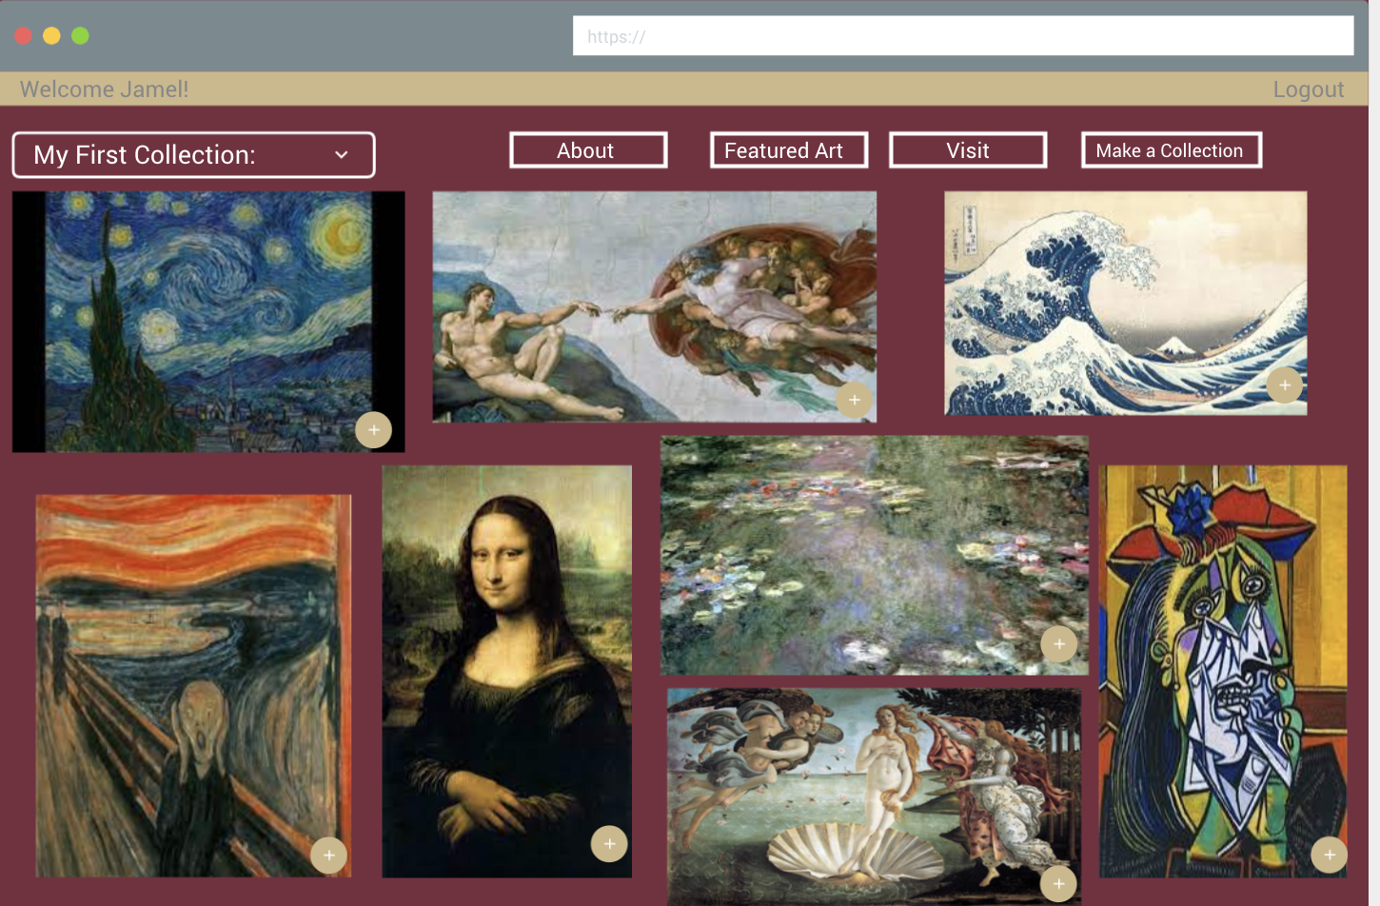
Collection Page

